Slide 1

Attendance

Slide 2

VPK or SR Attendance Data Issues
Be sure they have been reported
Be patient during fix and adjustments
Notes:
If you are still experiencing data issues with VPK or SR attendance, please be sure they have been reported and then be patient while they are being fixed.
Estimated payments have been made during the data issues but you are reminded that any over or under payments will be adjusted or collected based on final reimbursement.

Slide 3
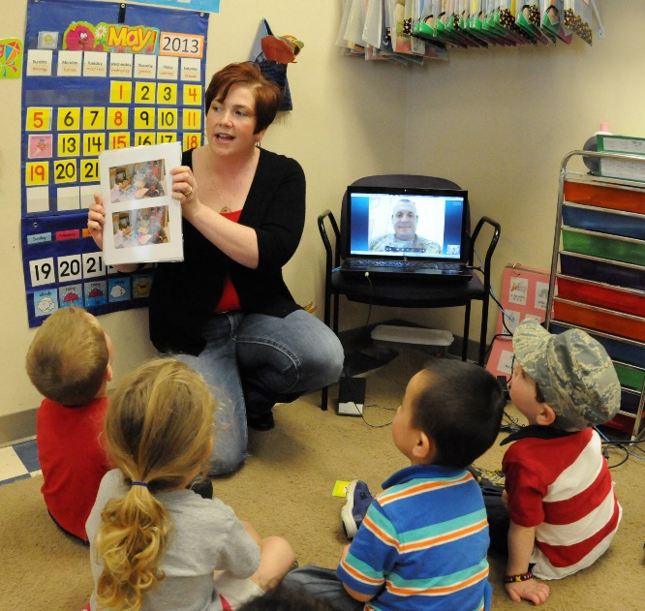
VPK Attendance
Requirements before submitting
Active Provider Profile
Certified VPK Provider Application
Certified VPK-20 Contract
At Least 4 Children Enrolled
https://providerservices.floridaearlylearning.com
Notes:
To submit VPK Attendance, log into your Provider Portal account. You need to check that you’ve met these 4 requirements before submitting your first attendance.
Active Provider Profile
Certified VPK Provider Application
Certified VPK-20 Contract
At Least 4 Children Enrolled

Slide 4
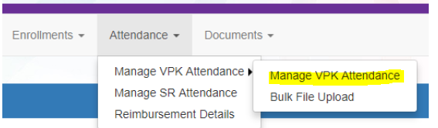
VPK Attendance
Backlog of attendance from Aug - March processed.
Regular monthly attendance to be submitted by the 3rd business day of each month.
Notes:
VPK providers have been working over the last few months to submit the backlog of attendance covering August through March. These attendance sheets have been processed for reimbursement and you are now on a regular monthly attendance submitted by the 3rd business day of each month. Any attendance received after the 3rd business day will be processed in the following month.

Slide 5

VPK Attendance
Detailed instructions at:
https://4cflorida.org/wp-content/uploads/2018/12/Provider-Portal-Submitting-VPK-Attendance-1.pdf
Provider Portal User Guide
Pages 106-110
Notes:
If you need more information, there are detailed step-by-step instructions available in the Provider Portal User Guide pages 106-110 or on the 4C website.

Slide 6

SR Attendance
Requirements before submitting
Active Provider Profile
Certified SR-20 Contract
Enrolled SR Children
Notes:
To submit SR Attendance, log into your Provider Portal account. You need to check that you’ve met these 3 requirements before submitting your first attendance.
Active Provider Profile
Certified SR-20 Contract
Enrolled SR Children

Slide 7

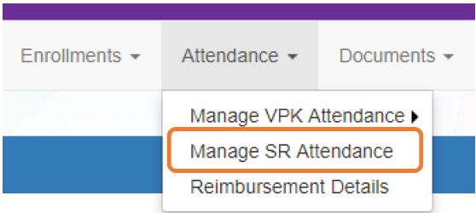

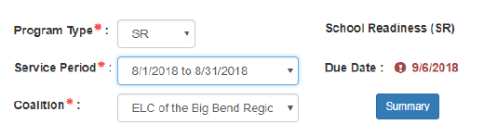

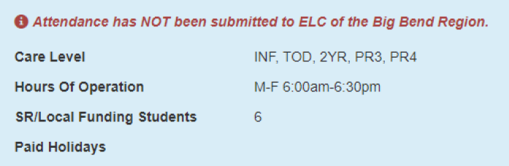
SR Attendance
Notes:
You’ll find SR Attendance in the Attendance tab, Manage SR Attendance. Select SR as the Program Type, then the service period, and the Coalition.

Slide 8
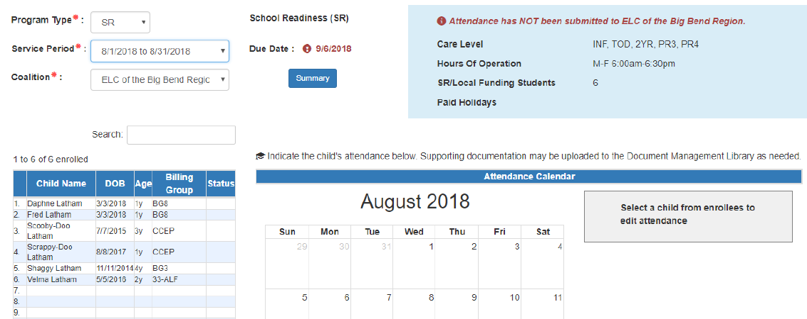
SR Attendance
Notes:
The SR Attendance Roster displays, defaulting to the current service period. The blue summary box to the right contains provider details and paid holiday information for the service period.
A service period is the month in which services were rendered. Child absences for the service period must be marked, saved, and submitted to the coalition. A due date is displayed for each service period. Providers that contract with multiple coalitions must submit an attendance roster to each coalition.
Children that are “Enrolled” or “Pending Parent Acceptance” are included on the SR attendance roster and their status will be displayed in the column marked in green. Children that are “Pending Parent Acceptance” are listed first and have an initial status of “PND”; children that are “Enrolled” do not have an initial status. When “PND” children are listed, a provider message will also appear. Clicking OK dismisses the message.
If a child is in “Pending Parent Acceptance” status, you should encourage the parents to go to their parent portal to complete the signature.
The search feature, shown in yellow, may be used to search for any criteria included in the roster (such as a name, DOB, age, billing group, or status). The summary feature shows the current/saved attendance information for all children in one view.

Slide 9

SR Attendance
Notes:
To record attendance, click on a child’s name to view their attendance for the month. You will see a summary of that child in the grey box shown on the right.

Slide 10
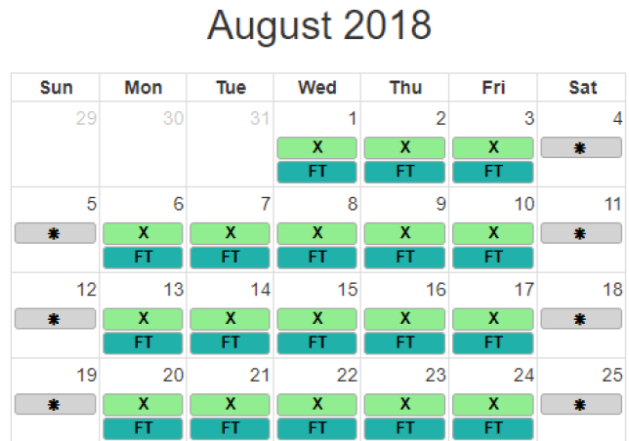
SR Attendance
Select a child and their schedule shows on the calendar
Notes:
The calendar displays each child’s schedule. You will not be able to mark attendance before their start date or after they’ve terminated care.

Slide 11
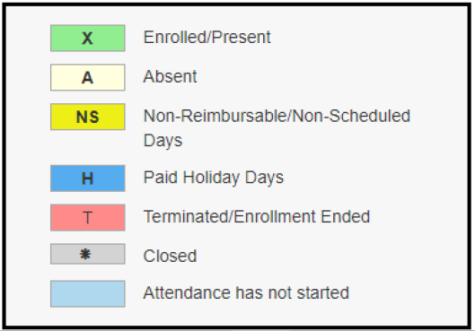
SR Attendance
Notes:
A code descriptions legend for marking attendance is provided in the bottom right of the sheet as shown on this slide.
Days the site is closed are marked with an asterisk “*.” (Grey)
Days the child is not scheduled to attend are marked with “NS.” (Yellow)
Days the child is scheduled to attend are marked with an “X” for present along with his/her scheduled unit of care.
Paid holidays where a child is also scheduled to attend are marked with an “H.” (Bright Blue)
While not required, it is recommended to click Save (below the calendar) before moving on to another child.

Slide 12
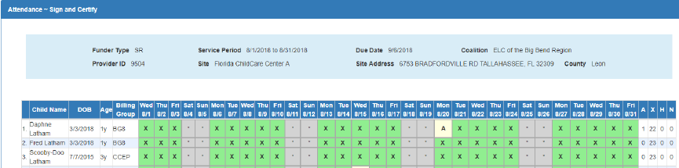
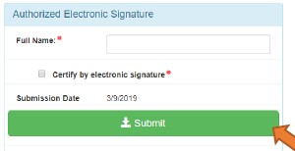
SR Attendance
Review of all attendance before final Sign and Certify
Notes:
When all child absences are marked for the month, click Save and then click the Submit to Coalition button. A window may appear if the attendance is being submitted early or late, or if no absences have been recorded. To continue to the Sign & Certify page, click Continue.

Slide 13
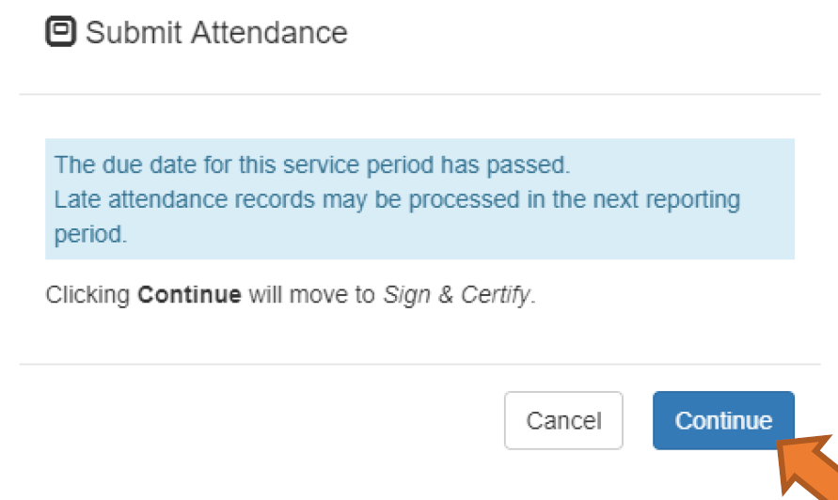
SR Attendance
Notes:
Attendance sheets should be submitted in month order by the 3rd business day of each month. Any attendance received after the 3rd business day of the month, will be processed the following month.

Slide 14
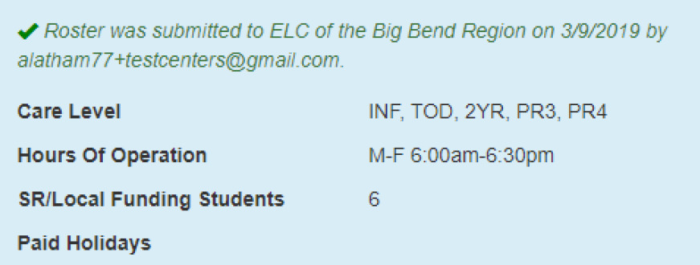
SR Attendance
Not Submitted
Submitted
Notes:
Upon submission, the screen returns to the SR Attendance Roster view with the current service period displayed. Select the submitted service period from the drop down. The submitted roster now has a submitted message and each child shows “SUB” for submitted in the status column. This status will change as the child attendance is processed by the coalition.

Slide 15
SR Attendance
Instructions:
https://4cflorida.org/wp-content/uploads/2019/03/Announcing-SR-Attendance-ORG.pdf
Contact 4C when:
Paid holidays are missing from the attendance calendar,
Information on the roster is incorrect (such as child’s date of birth, billing group, unit of care, scheduled days, termination date, etc.),
Enrolled children are missing on the roster,
Children appear on the roster more than once, or
Absences get saved multiple times on the same day.
These issues should be addressed prior to submitting the roster
Notes:
There are times when you’ll need to contact 4C for data corrections. These include when:
Paid holidays are missing from the attendance calendar,
Information on the roster is incorrect (such as child’s date of birth, billing group, unit of care, scheduled days, termination date, etc.),
Enrolled children are missing on the roster,
Children appear on the roster more than once, or
Absences get saved multiple times on the same day.
These issues should be addressed prior to submitting the roster as they will impact processing for reimbursement.
If any of the above occur, instructions for handling can be found on the 4C website.

Slide 16
SR Attendance
Detailed instructions at:
https://4cflorida.org/wp-content/uploads/2019/03/SR-Attendance.pdf
Provider Portal User Guide
Pages 112-117
Notes:
There are detailed step-by-step instructions available in the Provider Portal User Guide pages 112-117 or on the 4C website.

Slide 17

SR Attendance
If you need to call:
407-532-4251.
If you need to leave a message because we are helping another provider, please:
Leave only one message and
Allow 1-2 business days for a return call.
Notes:
You’ll get a faster response using the data issues upload process outlined in the instructions for handling SR attendance issues, however, if you need to call, we have a designated phone number for you. Please leave only one message and allow for 1-2 business days for a return call. We are minimizing the number of staff answering phones so that they may focus on the correction of data issues and the processing of attendance. Our goal to make needed corrections for everyone so that we can move forward with SR reimbursement.

