Slide 1


Screening of Children in the School Readiness Program
EFSM Providers information

Slide 2

If you have a contract for the School Readiness Services Program, you have agreed to participate in the ELCOC approved child screening program.
Screening of Children in the School Readiness Program
Department of Education
Division of Early Learning
Rule 6M-4.720
A developmental screening shall be conducted for each child aged 6 weeks to 60 months with parental consents. (Parent may decline)
Children shall be screened no later than 45 days calendars days after first enrollment, after being terminated or withdrawn from the School Readiness program.

Slide 4

What is a developmental screening? Why is it important?
ASQ-3 can help identify child’s strengths as well as any areas where child may need support.
Communication
Physical ability (fine motor & gross motor)
Social skills
Problem-solving
A developmental screening is a quick check of a child development. Provides a look at how children are doing in important areas:
Screening young children is an effective way to assess developmental progress during a child’s first years of life and to determine any necessary action at a time when it can have its greatest impact. (www.agesandstages.com)

Slide 5
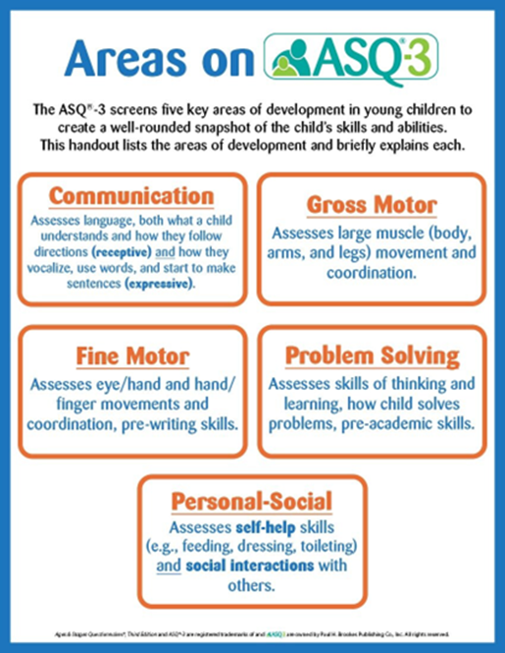
What Is ASQ-3?
ASQ-3 is a set of questionnaires about children’s development. A screening provides a quick look at how children are doing in important areas.
ASQ-3 can help identify your child’s strengths as well as any areas where your child may need support.
Only need 10–15 minutes.
There are 21 questionnaires that you can use with children from 1 month to 51⁄2 years old.

Slide 6
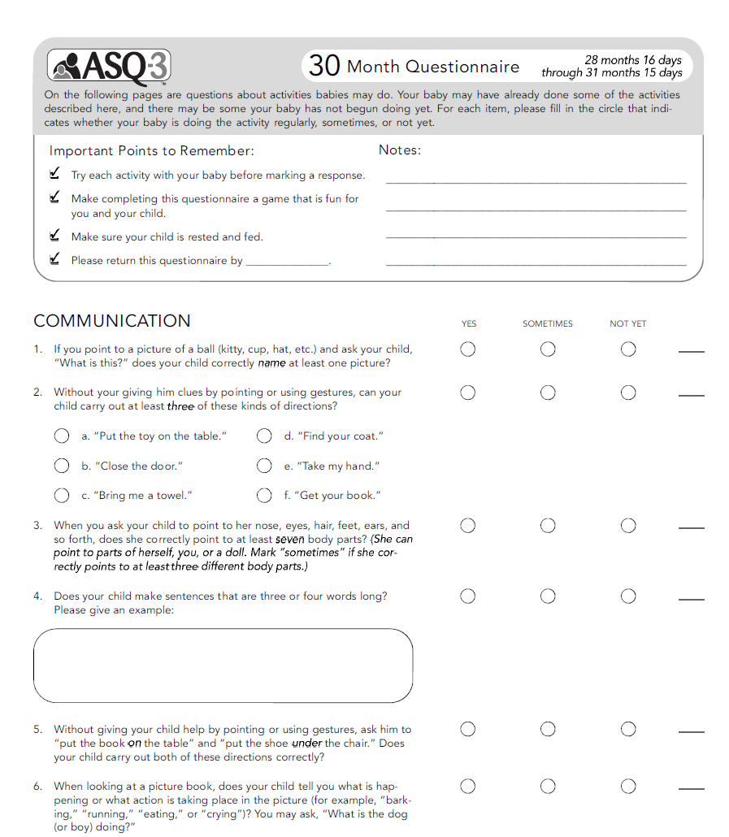
ASQ-3
Here’s how ASQ-3 works:
  Possibles answers (based on what your child can do now):
    “yes”
    “sometimes”
    “not yet”
  To answer each question, you can try fun and simple activities with your child.
  These activities encourage your child to play, move around, and practice day-to-day skills.

Slide 7
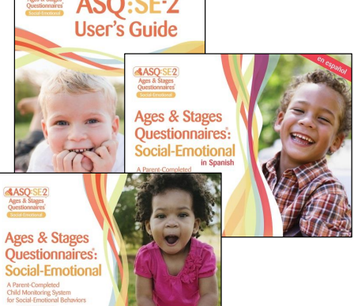
What Is ASQ SE-2?
ASQ SE-2 is a set of questionnaires about behavior and social-emotional development in young children.
There are nine questionnaires for different ages to screen children from 1 month to 6 years old.
ASQ:SE-2 can help identify your child’s social-emotional strengths and areas where your child may need support.

Slide 8
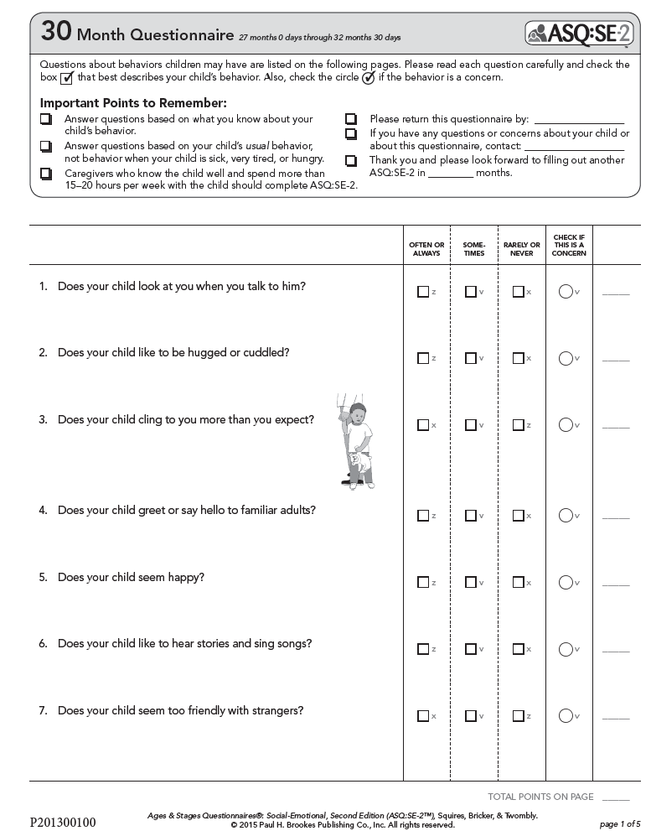
ASQ SE
Here’s how ASQ:SE-2 works:
Possibles answer:
  “often or always”
  “sometimes”
  “rarely or never”
Answer based on what you know about the child.
Note if any behaviors concern you.
Answers help show child’s strengths and areas where he or she may need support.

Slide 9

Screening Submission
The “Single Statewide Information System (SSIS)” is the designated system used to conduct screenings and provide screening information to early learning coalitions.
Use your Provider Services Portal for screening submission.
Log into Provider Portal
  https://providerservices.floridaearlylearning.com
Go to:
  Enrollment
  SR Enrollment
  Preschool Development
  Developmental Screening
  Incomplete
You should see a list of children who need to be screened and their due date information.
Go all the way to the right of the page and select your preferred language. This should take you to a new page where the ASQ online site will open.

Slide 10

If you have any questions before, during, or after completing the screenings, please contact our Early Childhood Screening Specialists Team at 407-841-6607.

